Slide 1





Tamar Raz, PHD

Slide 2


The Technology Transfer Company of Hadassah University Hospitals
Dr. Tamar Raz, CEO Oct 2018

Slide 3

We transform cutting-edge research into marketable healthcare technologies
We turn knowledge into viable IP ready to be licensed
We facilitate and enhance business relationships with the healthcare industry
We provide hands on guidance to promote financing of innovative ideas
We provide flexible business
and revenue models, allowing us to promote a variety of deals

Slide 4


Technology Transfer
The Secret Engine Behind Israel’s Success

Slide 5






A key to some of ISRAEL’S biggest blockbusters
Exelon®

Slide 6


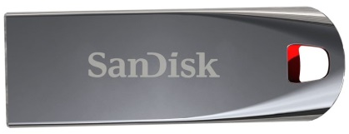
A key to some of ISRAEL’S
biggest blockbusters
CHERRY TOMATO

Slide 7


HADASSAH
MEDICAL CENTER

Slide 8
a booming innovation hub
1M
patients treated
annually
45 ORs
50%
Of the National Science
Foundation Awards
to bio-medical research
in Israeli hospitals
43K
surgical procedures
annually
1,300
beds
Our doctors and scientists are on the frontlines, uniquely positioned to pinpoint ever-evolving medical needs.
>2000
Scientific publications
in the past 5 years
4,800
employees
900
physicians
12
Winners of
“Israel Prize” awards
1500
nurses

Slide 9
Multitude of resources. Unlimited opportunities.
Oncology
Metabolic/Liver
Immunology
Cell Based Therapies
Neuroscience
Cardiovascular
Ophthalmology

Slide 10
Multitude of resources
Clean Rooms (GMP)
for production of stem-cells, and recombinant proteins for human injection
Genomics
Tissue Bank
Access to human samples:
IRB supported collection of blood and tissue samples
Cyclotron
(radio labeling of both routine & unique compounds)
Large Animal Surgery Room
Hadassah Brain Labs
Knowledge Center for in vitro and in vivo models related to CNS diseases
HCRC - Hadassah Clinical Research Center
phase I center and numerus Phase II and III clinical trials being managed simultaneously at Hadassah
Animal imaging
Micro PET / CT

Slide 11

Hadasit cGMP for biopharmaceuticals production:
Your partner for 1st in man and more
From bench
To product
To patient
Our expertise & experience:
Over 25 years of biopharmaceutical production experience
Production of over 50, 1st in man biopharmaceuticals
Production for Phase I, II & III clinical studies
Ministry of Health approval certificate
Contact information: Dr. Linda Rasooly, Director of the cGMP facility;
mail: LINDAR@hadassah.org.il; phone: 052-6429936

Slide 12


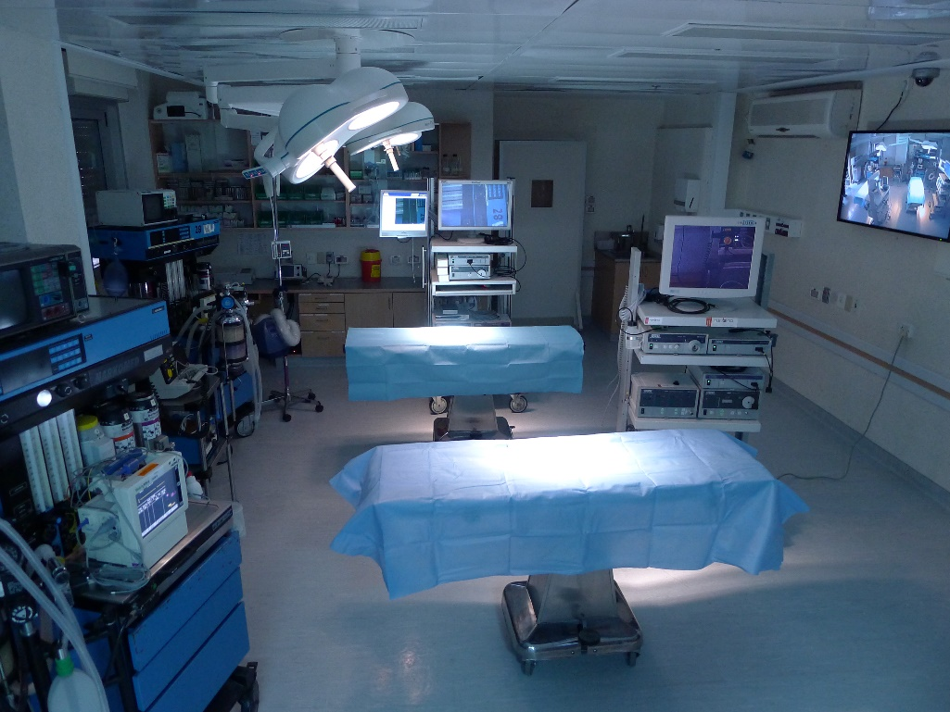




Surgical innovation & technology center
Headed BY Prof. Yoav MINTZ
R&D expertise
Large animals OR
Access to leading experts
Unique animal models
Surgical training services

Slide 13


Hadasit in numbers
Over 250 active patent families
71%
Pharma
20 new
Commercialization
agreements per year
About 40% of them licensed to industrial companies
29%
Med tech
100 new
R&D & service agreements per year

Slide 14
Hadasit in numbers
Holdings in
110 companies
Over 50 spinoffs established
15 of them
are public

Slide 15

Our transfer model: from discovery to revenues
Revenue
Sharing
Discovery &
Innovation
40%
The inventor/s
20%
For Research
40%
The Institution
Follow Up
on Contract
Evaluation
Biz dev &
Commercialization
Patenting
& Marketing
Strategy

Slide 16

portfolio

Slide 17






















Our technology transfer success
PHARMACEUTICALS
DIGITAL HEALTH
MEDICAL DEVICES
LIFE SCIENCE & BIOTECH

Slide 18




Biodesign israel
An academic program which creates groups of Medical Students, Engineering Students, Business Students, and Law Students working together toward a single Biotech Product
Original concept - Stanford University
Bioengineering
Hebrew University
Hadassah
Medical Organization
Needs
Analysis
Inception
Design
Prototype
5 Years
20 projects
8 Projects already funded by external investors
External funding > NIS 10 M
4 technologies already in clinical trials
Provisional Patent
Business Plan

Slide 19


A BREATH OF FRESH AIR
FOR THE ISRAELI LIFE-SCIENCES START-UP ECO-SYSTEM

Slide 20
HADASSAH
Innovation hub
HADASIT
Commercialization experts
We Transfer
to Market
We Invent

Slide 21
HADASSAH
Innovation hub
HADASIT
Commercialization experts
BRINGING IT ALL TOGETHER

Slide 22

HADASSAH
Innovation hub
HADASIT
Commercialization experts
We Transfer
to Market
We Invent
We Invest

Slide 23
Maximizing equity
With a multi-stage investment model, ranging from discovery seed to VC class investments
01
02
03
04
Scouting by industry leaders
Discovering promising technologies, developed outside or within Hadassah
Proof of concept:
innovation funding
5-10 new projects per year up to $100K per project
Skin in the game: seed funding
  Seed investment of up to $1M per project invest at least 50% of fund in POC graduated technologies
Watching them grow
Round A Co-investment maintain at least 25% Hadaseed equity

Slide 24
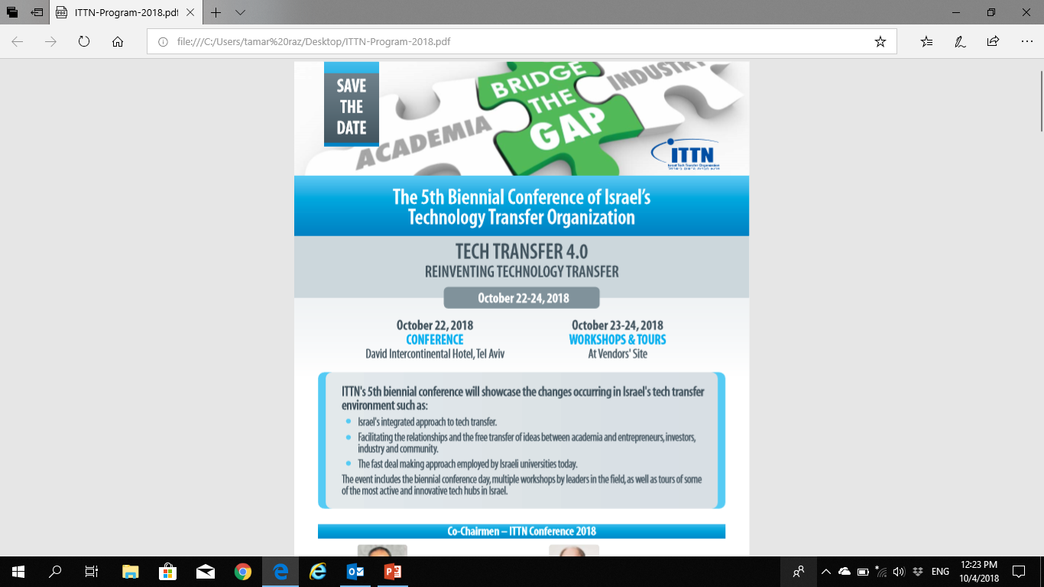

Slide 25


THANK YOU
TAMAR RAZ - CEO | rtamar@hadassah.org.il | www.hadasit.org.il

