Slide 1
The Emerging Arab Israeli Hi Tech Economy
Jimmy Levy
October, 2017

Slide 2
Arab Israeli Society - Economic and Social Gaps
Population of Israel
Participation in Workforce
Contribution to GDP
Employment in Hi-Tech
Unemployed
Poor Population
44%
25%
20%
Underrepresented in “positive” parameters
13%
Overrepresented in “negative” parameters
8%
4%
Percentage of Arabs in the Population
Percentage of Arabs in the Work Force
Percentage of Arab contribution
to GDP
Percentage of Arabs among Hi-tech
Employees
Percentage of Arabs among Unemployed
Percentage of Poor
Population
Adapted from Shaldor, Collective Impact Initiatives 2015
2

Slide 3
Arab Israeli Economy - An Emerging Market within Israel’s Developed Economy
Parity will yield $10B annually to Israel’s economy
Education paving the way to higher paid professions
Government investments
$4B committed over next 5 years
Chief Scientist programs focused on Arab entrepreneurs
Participation in Al Bawader
3

Slide 4
Al Bawader at a Glance
First investment fund focused on the Arab private sector
$50m committed capital
Private and public partnership
Our vision: Expand “Startup Nation” to include Arab community
Our mission: Generate healthy returns for our investors
Same investment criteria as other funds
8 investments in early stage companies
Key challenges:
Investing in first time entrepreneurs
Recruiting experienced management teams
4

Slide 5
Webteb: #1 Arabic Medical Site

Slide 6
Webteb: Unparalleled Arabic Medical Content

Slide 7
Webteb: Launching Telemedicine Service in 2018

Slide 8
Shablol: #1 Kids Social Network in the Arabic world

Slide 9
Datumate - Integrates state of the art drone, computer vision and photogrammetry to automate field to plan processes
Datumate delivers comprehensive field data and analytics on a daily basis to power the $24B BIM Construction Infrastructure industry

Slide 10
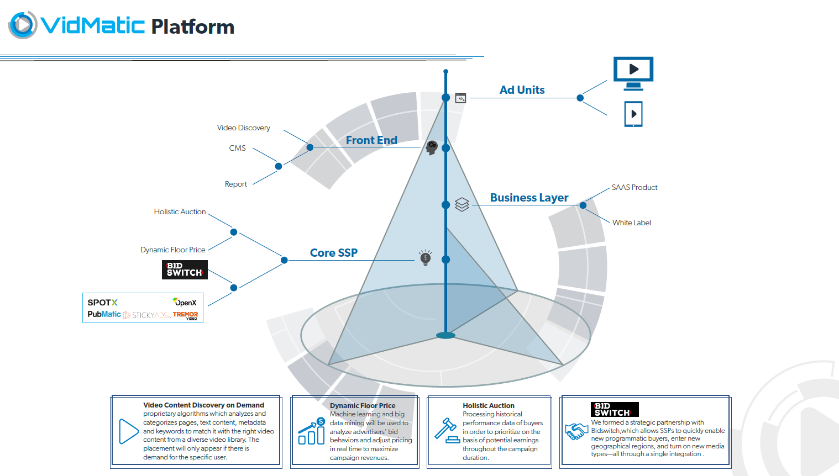
Vidmatic - Comprehensive video ad platform targeting publishers in emerging markets

Slide 11
Galil Software - #1 Software Service Provider to Israeli High Tech
200 engineers
Headquartered in Nazareth
Government programs
Profitable
Expertise in high margin markets (DevOps, Automated QA)
600+ former employees work in Israeli hi-tech

Slide 12
Emerging Arab Israeli High Tech Economy 2010 vs 2016
Accelerators,
Incubators, VCs
1 to 5
Startups
supported by CSO
2 to 25
Number of
start ups
25 to 100
High tech jobs in Nazareth
50 to 600
Professionals
employed in high tech
300 to 2300

Slide 13
Thank You!

