Slide 1
Marcelo González Robles
Chilean Technology Transfer Strategy: Lessons and next steps

Slide 2
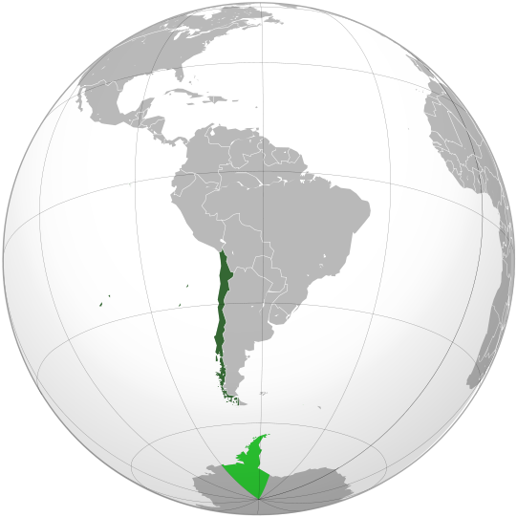
CHILE AT A GLANCE
Population: 17.7 million people
Capital City: Santiago
GDP per capita, PPP 2015: US$23,563
Inflation dic 2015: 4.4 %
Unemployment 2015: 6.2%
Official Language: Spanish
Currency: Chilean Peso (CLP)
Corporate Tax: 22.5% - Value Added Tax: 19%
Major Trade Partners: USA, Japan, China and Europe
Labor force: 8.7 million people

Slide 3
Main Sectors
CHILE AT A GLANCE
Mining
World’s principal producer of copper (32%), nitrates (100%), iodine (58%) and lithium (45%) and the sixth largest silver producer
Salmon
World’s 2nd Largest producer
6.0 million people market
Forest
Top 10 in roundwood and pulpwood
Leader in LatAm
Wine
World’s 5th Largest producer
16.9 million people drink a glass of Chilean wine
Fruits
The world’s biggest exporter: Fresh blueberries, Fresh grapes, Fresh cherries, Prunes and Dehydrated apples
Main issues:
Undiversified productive matrix.
Limited value added in exports.

Slide 4
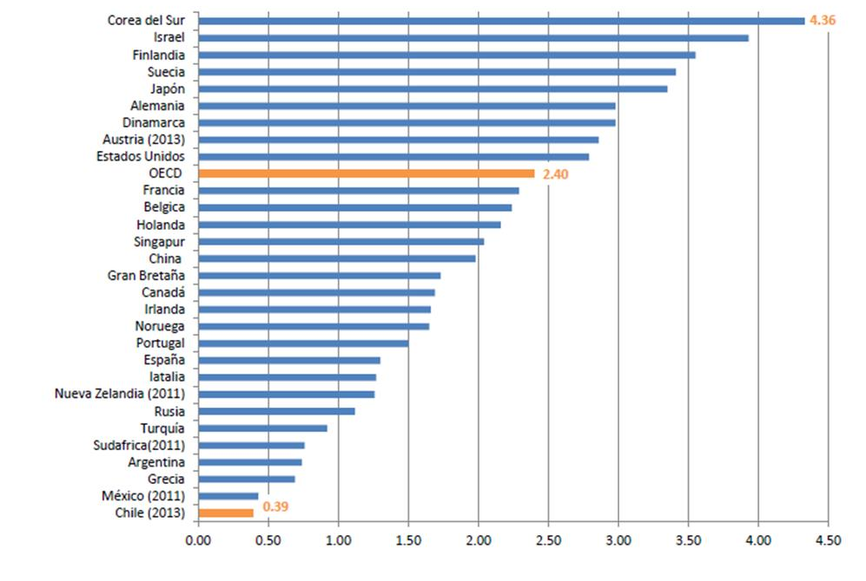
STILL LOW R&D EXPENSES AND LIMITED BUSINESS EFFORT
(As a percentage of PIB, 2012 or latest year available)
Public+Intl: 0,26%
Private R&D: 0,13%
Source: Main science and technology indicators database, OECD, Dec 2014.

Slide 5
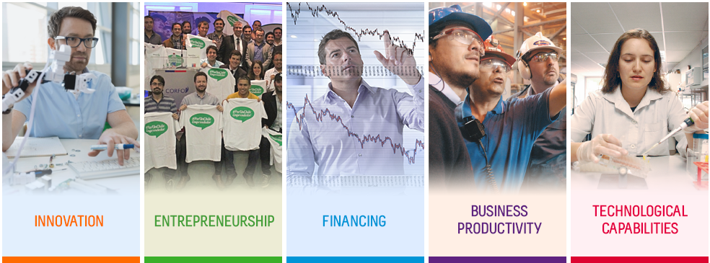
CORFO: THE ECONOMIC DEVELOPMENT AGENCY
since 1939
Our mission is to improve the competitiveness and the productive diversification of the country by encouraging investment, innovation and entrepreneurship, strengthening in addition the human capital and technological capabilities to achieve a sustainable and territorially balanced development.
Innovation grants
R&D contract research grants
R&D tax incentive
Seed Capital
Incubators
Co-Works
Start Up Chile
Guarantees for financing SMEs
PE & VC Funds
Early Stage VC Funds
SMEs programs
Labor skills
Smart Specialization programs
Technology centres
R&D Consortiums
Tech transfer (TTOs and Hubs)

Slide 6
TECHNOLOGY TRANSFER IN CHILE: TIMELINE
First Group of Universities create small units to enhance IP protection and technology commercialization (2000 and even before).
20 Universities and 1 R&D Center were funded by Corfo to install their TTOs as a formal process within their Institutions (2012).
26 Universities and 3 R&D Centers receive Corfo funding to install and strengthen their operations.
The same community (and more) also participates in 3 Technology Transfer HUBs. (2015-2016).
2000
2005
2010
2015
2020
1st TTO program (2012-2013)
Go to Market program (2012-2015)
Training programs for Technology managers (2012-2016)
2nd TTO program (2015-2016)
TTO Formation program (2016 onwards)
TTO Strenghtening program (2016 onwards)
Technology Transfer Hub program (2016 onwards)
OECD: Review of Chilean Innovation Policy (2007)
First National Guidelines for Innovation and Competitiveness (2007 – 2008)
Technology transfer World Bank review (2009)
National Agenda for Innovation and Competitiveness (2010-2020)

Slide 7
CORFO PROGRAM TO SUPPORT TTOs: MAIN RESULTS
1ST TTO PROGRAM:
TTO Installation, 2012-2013
2ND TTO PROGRAM:
Commercialization, 2015-2016(Q1)
Creation and Formalization of 21 new TTOs
15 TTO Supported
Total Portfolio of 441 Technologies
First IP Policy and Regulation
Initial Portfolio of Technologies
100 Invention Disclosures
Recruitment of New Teams
254 Invention Disclosures
43 new softwares
First Strategic and Operational Plan
First Training Programs for TTO Managers
5 License Agreements
115 priority patent applications
44 License Agreements
2 Spin Offs
9 Spin Offs
52 new research contracts

Slide 8
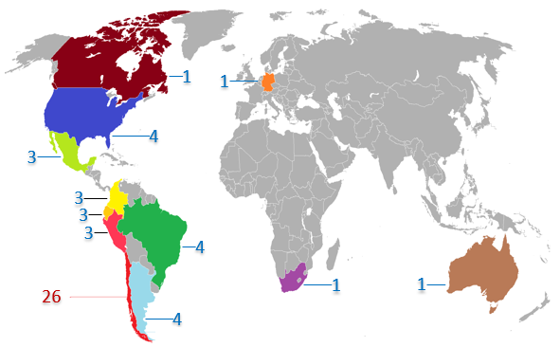
CHILEAN TTO’S NEW LICENSE AGREEMENTS (year 2015, 15 TTOs)
Most deals have a national scope (Chile) where the most important fields of application are: agriculture, aquaculture, life sciences, engineering, mining and ICT.
There is a number of new deals with presence in America, and with more emphasis in South America.
There is a huge opportunity for growth in the rest of the world: 1 deal in Europe, Africa, and Oceania.

Slide 9
TECHNOLOGY TRANSFER OFFICES
Lessons Learned
DECLARATIONS
Commitment of the highest authorities, including research. Individual efforts to pursue technology transfer won't be enough.
RULES
installation of minimum conditions for technology transfer, i.e. scheme of incentives, IP policy and regulation, conflict of interest policy and regulation, etc.
DEFINITIONS
After years of operation, the office may try, but will never achieve results according to a strategy that not follows the Institution's principles, like its mission, vision and objectives.
ONCE THE ABOVE ADDRESSED…

Slide 10
TECHNOLOGY TRANSFER OFFICES
Lessons Learned
TEAM:
According to the DEFINITIONS, impacting on functions, level of specialization, etc.
TOOLS:
Required for knowledge management. Consistent with the team needs
COMMUNICATIONS:
Meeting industry and academia needs.
COMMERCIALIZATION
CASES
MEASURING:
Reasonable metrics in accordance with reasonable time limits (GOOD PRACTICES vs REVENUES vs IMPACT).
TECHNOLOGY PORTFOLIO:
“As a way of thinking”. To prioritize work in terms of technology management, IP costs, EFFORTS.
Creating “better problems” to test the RULES and PROCESSES, and inviting more people to participate.

Slide 11
Current Strategy and next steps…

Slide 12
Technology Transfer Strategy
2016 - 2020
3 interventions
TTO Formation:
Creation of new TTOs
Building institutions, policies regulations
Kick off of their operations
9 projects: 7 Universities, 2 R&D centers
Max Budget per Project: M USD 200
Project Duration: 18 months
Technology Transfer HUB:
A collaborative model for Technology transfer between Universities and R&D Centers to commercialize the chilean technologies with the highest value, globally.
A flexible scheme with specialization in priority sectors of R&D.
Delivery of required services to level TTOs and other institutions within the system.
Delivery of programs to expose chilean Technology-based spin-offs, globally (Go to Market).
TTO Strenghtening:
Scouting of R&D results
Management of IP
Relation between academia and industry
Promotion of innovation within academia
Sophistication in the management of Technology portfolios
20 projects: 19 Universities, 1 R&D center
Max Budget per Project: M USD 270.
Project Duration: 24 months
ON CAMPUS
OFF CAMPUS

Slide 13
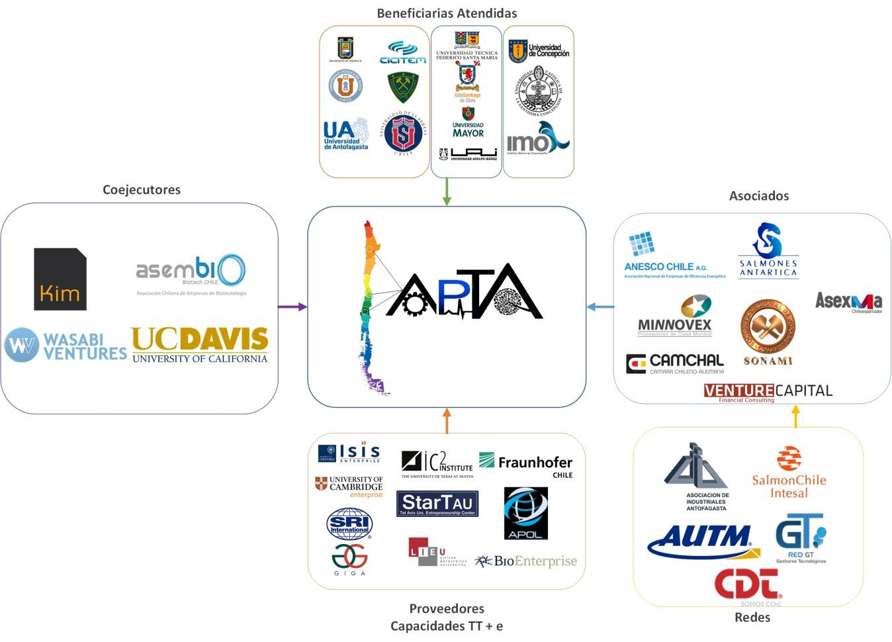
Know-Hub Chile
Technology Transfer HUB
Awarded Projects
3 projects with specialization of functions in specific socio-economic sectors: agriculture, aquaculture, health, industrial production and Technology, and energy.
5 years duration, MM USD 20,3 program budget.
26 Universities, 8 R&D Centers, 4 International Centers of Excellency, 2 Investment Funds and11 Business Associations.

Slide 14
http://startupchile.org/

Slide 15
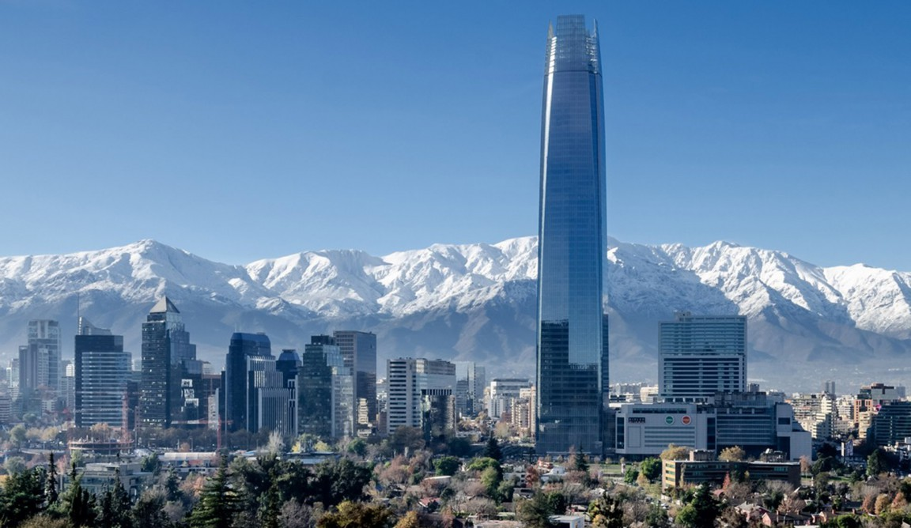
Thanks!
#OTLSCORFO
@CORFO

